Slide 1

Grounds Tester GT400 or GT600

Slide 2
Overview
Theory of Operation & Principles
Equipment Overview
Procedures
Features

Slide 3
Theory of Operation & Principle
Using high current transformers, the GT400 or GT600 is an AC (alternating current) device that circulates 400 amps or 600 amps respectively through the Grounding Cable Assembly.
The Maximum Voltage Drop allowed for a Grounding Assembly is based on ASTM Standard F2249-03.
NOTE: It is up to each Utility to review this ASTM Standard and determine if this guideline follows their criteria for providing Personal Protection for their workers.
A 120VAC, 20 Amp outlet is required for proper operation.

Slide 4
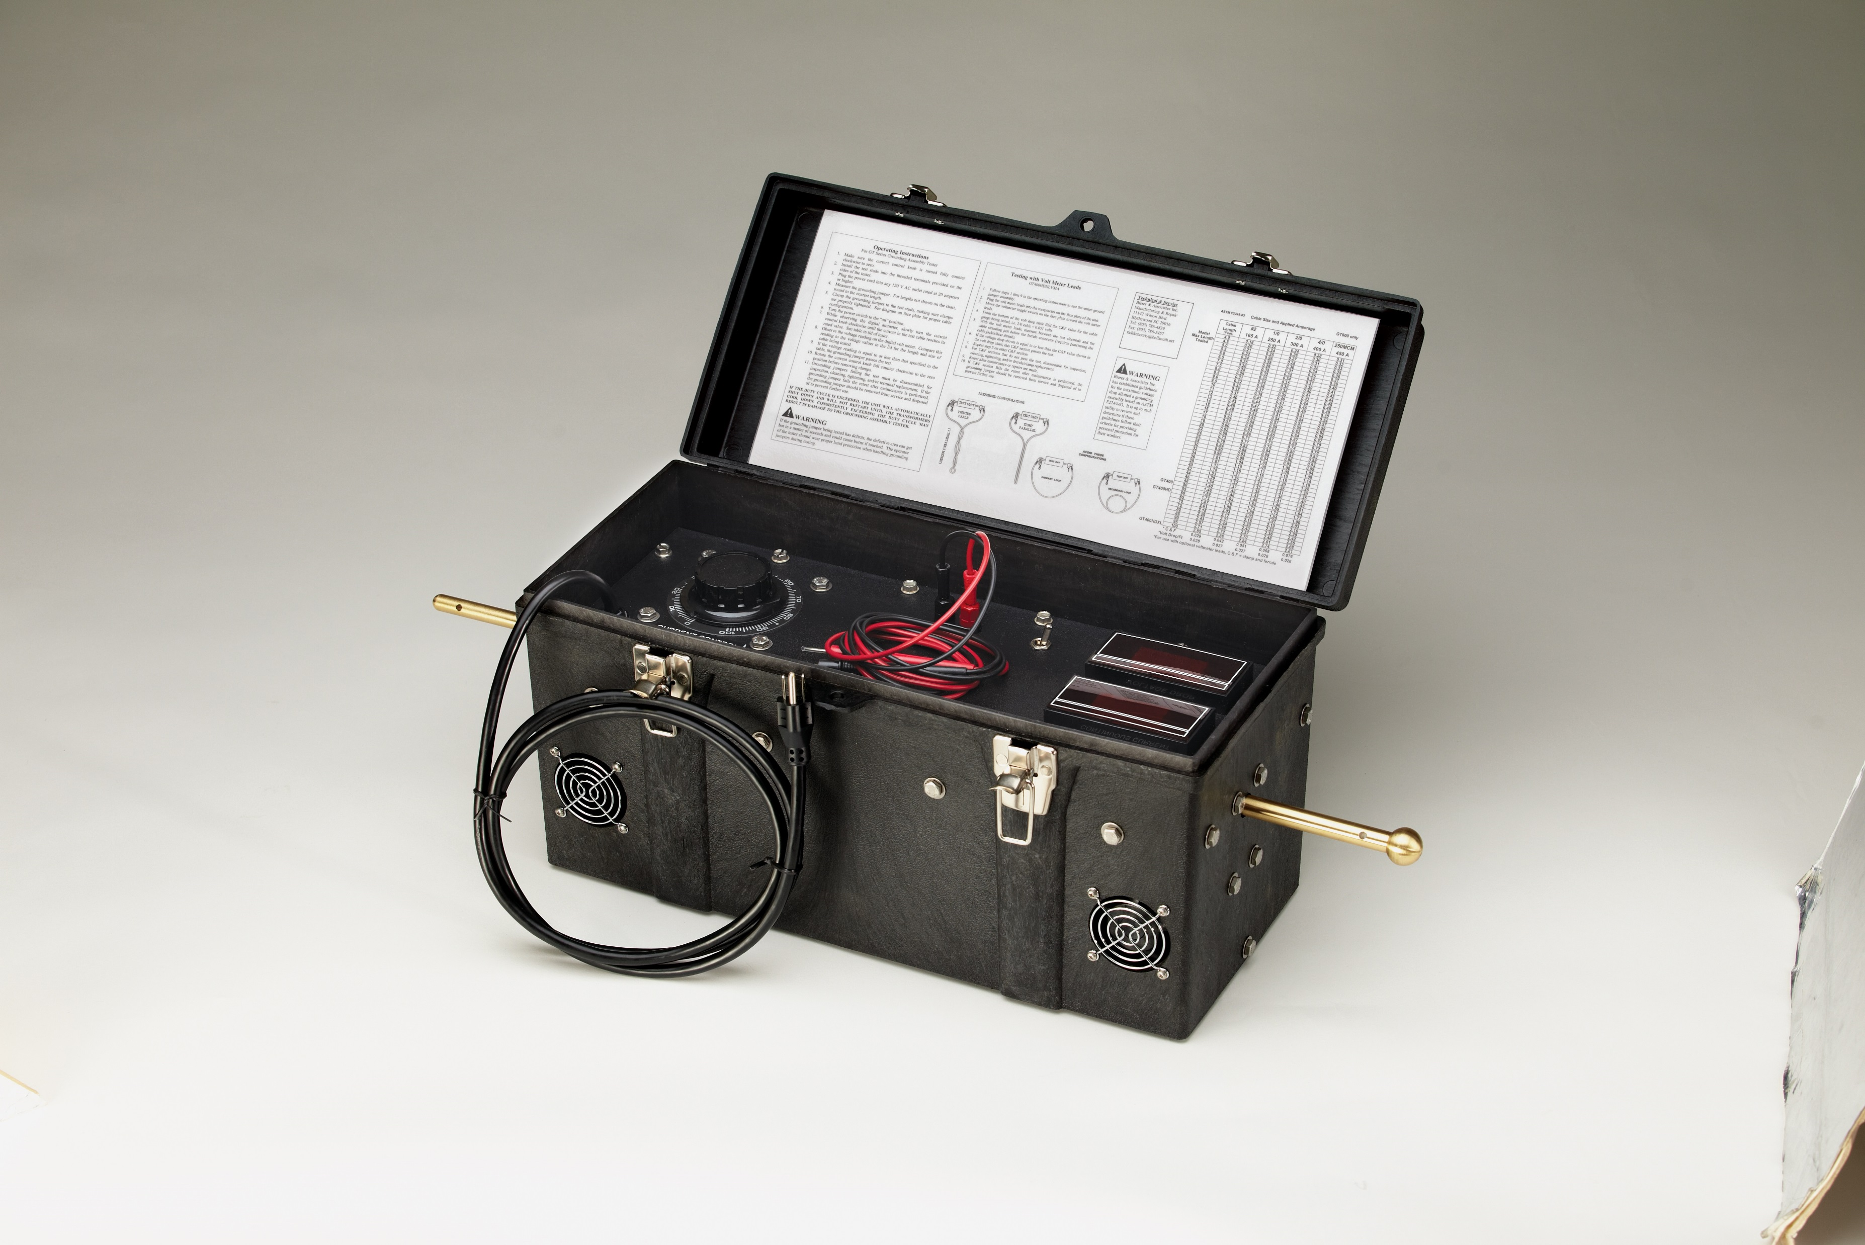


Grounds Tester
Operating Instruction Placard
Power On/Off
Switch
Current
Control
Volt Meter Addition Leads
(Optional)
Clamp
Electrode
Volt Meter Addition
External/Internal Switch
(Optional)
Volt Drop Display
Current Display
120VAC
Power Cord
Clamp
Electrode
Cooling Fan/Vents

Slide 5
Procedure for Testing Grounding Assemblies
Determine the GT is plugged into a suitable 120VAC, 20 Amp power source.
With the GT in the Power “OFF” Switch position, attach the proper Electrodes per the Grounding Assembly to be tested. Make sure the Electrodes are threaded into the termination blocks and NOT loose.
Measure the total length of Grounding Assembly to be tested from Clamp to Clamp and make a note of this length. If the length is not listed on the “Operating Instruction Placard” provided in the GT, round the length to the nearest foot.
Attach the Grounding Assembly to the Electrodes and verify a secure (tight, inserted, etc.) attachment is made for each end.

Slide 6
Procedure for Testing Grounding Assemblies
Conform the Grounding Cable into one of the two Required Configurations shown below.
Note: If one of these two Configurations is NOT used, then it may become possible to fail a good cable.

Slide 7
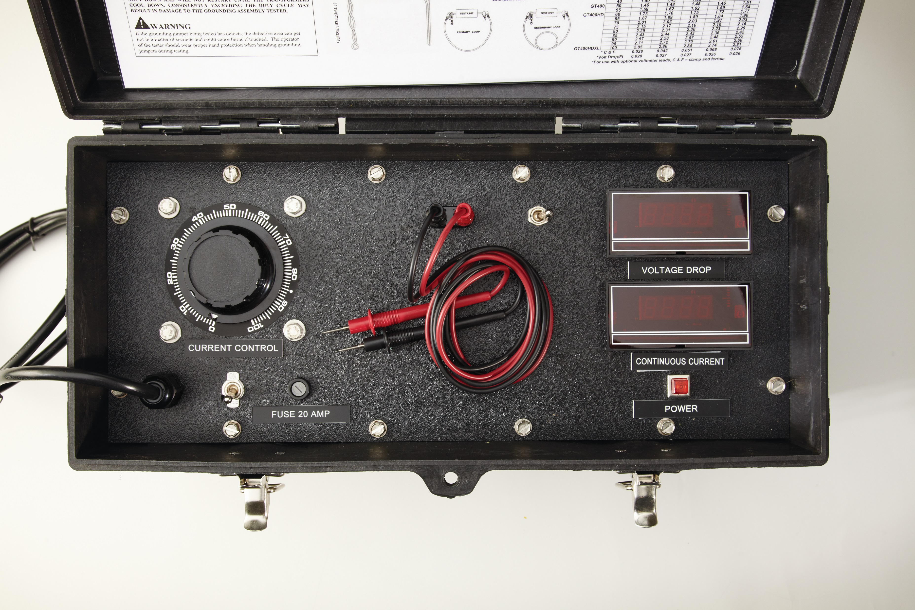
Procedure for Testing Grounding Assemblies
6. Verify that the GT “Current Control” knob is turned to “0” or completely in the Counter-Clockwise position as shown below.

Slide 8
Procedure for Testing Grounding Assemblies
Turn the Power Switch to the “ON” Position. If the GT is equipped with a “Volt Meter Addition”, verify the “Volt Meter Addition External/Internal Switch” is in the “External” position before proceeding.
While observing the “Current Display”, slowly turn the “Current Control” knob clockwise until the current in the Grounding Assembly reaches its rated value listed on the “Operating Instructions Placard”, i.e. 2/0 cable should be adjusted to 300 Amps.
Observe the “Volt Drop Display”, compare this reading to the values listed on the “Operating Instructions Placard”. Use the length from Step #3 and the size cable being tested to quickly determine a Pass/Fail result. If the Grounding Assembly Fails and the GT is equipped with a “Volt Meter Addition”, go to Step #10, otherwise go to Step #12
Turn the “Volt Meter Addition External/Internal Switch” to the “Internal” position.

Slide 9
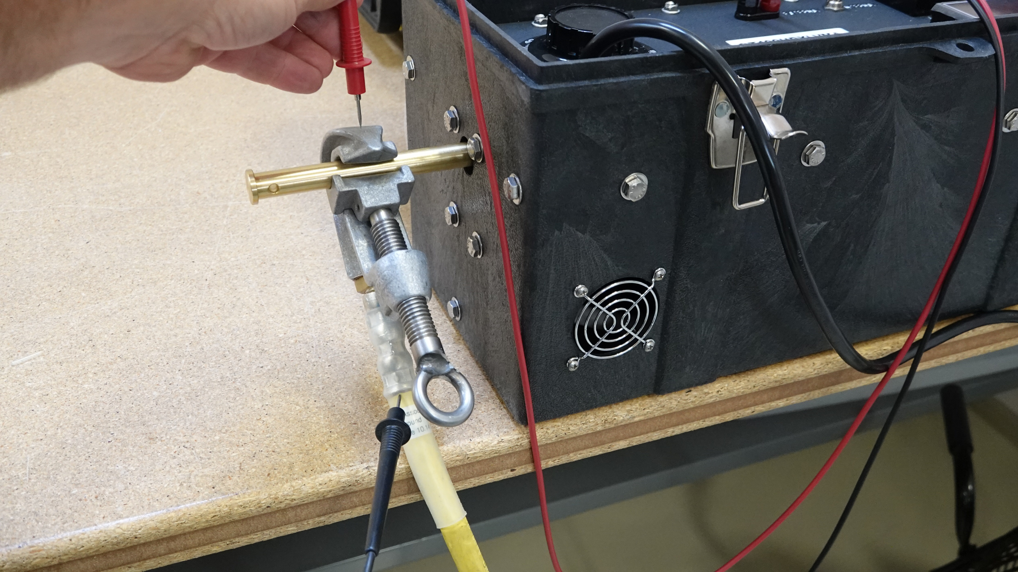
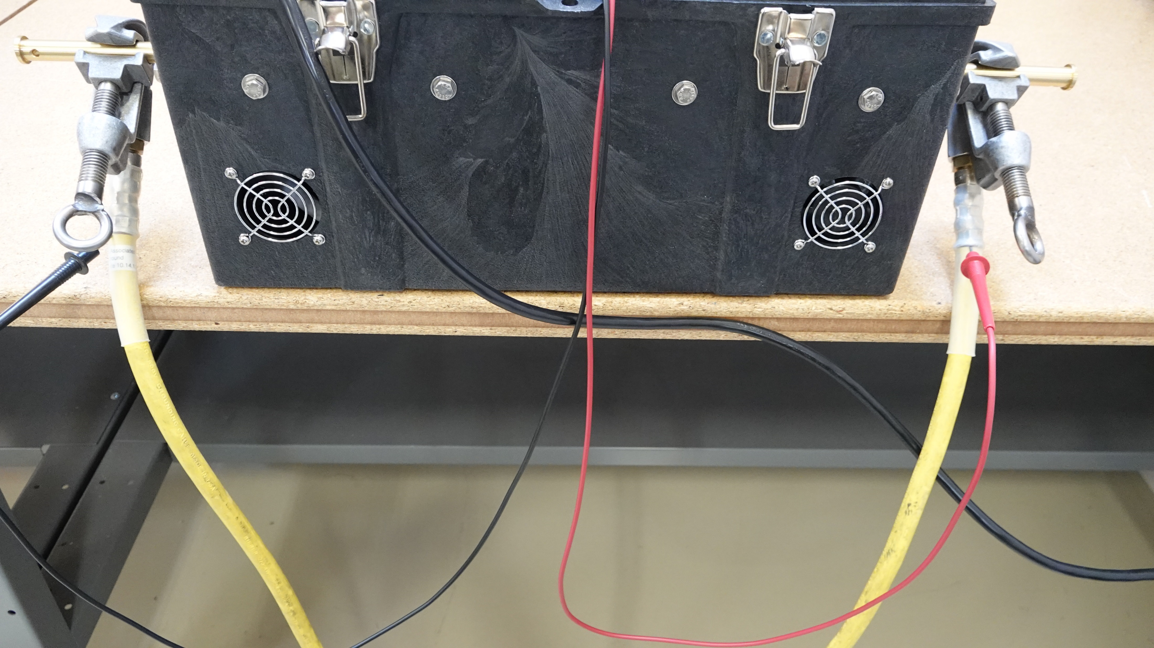
Procedure for Testing Grounding Assemblies
11. The “Volt Meter Addition Leads” can now be used to quickly determine where the problem exists such as, a Clamp & Ferrule Volt Drop Test shown below on the left or a Cable Volt Drop Test shown below on the right. Compare the Clamp & Ferrule Test to the “C&F” Value and the Cable Volt Drop Test to the “Volt Drop/Ft.” located at the bottom of the “Operating Instructions Placard”.
Contact to
Clamp
Pierce Strain Relief
to Contact Cable
Pierce Strain Relief
to Contact Cable on
Both Ends

Slide 10
Procedure for Testing Grounding Assemblies
12. Rotate the “Current Control” knob counter-clockwise before removing the Grounding Assembly ends from Electrodes.
13. Disassemble, Inspect, Clean, Tighten, etc. and/or replace parts as necessary before re-testing Grounding Assembly. If the Assembly Fails a re-test after maintenance is performed the Grounding Assembly should be REMOVED from Service and properly Disposed of to prevent further use.
14. If more than one (1) Assembly is to be tested and to ensure Maximum Cooling of the Grounds Tester, do NOT turn unit Off between tests.

Slide 11
Features
Durable, Portable Grounding Assembly Tester
The ONLY (includes continues current or resistance) Ground Assembly Tester that Correlates over 90% vs. an Ultimate Current Test conducted by Third Party Evaluation(s)
Convenient 120 Volt, 20 Amp required power source
Easy-to-Use Pass/Fail Chart for Efficient Operation and Time Savings
Optional Volt-Meter Addition to Quickly and Easily Determine problem areas that Eliminates unnecessary repairs/costs.

Slide 12
Bierer Meters Grounds Tester
www.bierermeters.com
For additional questions or concerns, please call 803-786-4839 or
Email us at customer_service@bierermeters.com

