Slide 1
PHASING RANGER 1
LONG RANGE PHASING TOOL

Slide 2
Overview
Theory of Operation & Principles
Introduction to the Phasing Ranger
Equipment Overview
Procedures
Features

Slide 3
Theory of Operation & Principle
Using a microprocessor, the Phasing Ranger 1 compares the phase angle in the Base or Send Unit to the Field or Receive Unit.
The Base Unit measures the “Reference” phase angle while plugged into a 120V wall socket connected to the power grid.
The Field Unit measures the phase angle in conjunction with a Meter Probe and compares the “Reference” phase angle to the “Field” phase angle.
The result is displayed on the Meter Probe from 0 to 359 degrees.

Slide 4
POWER PLANT TO THE HOUSE
With the Phasing Ranger 1 (PR1), now
you can phase in Real-Time from any
two points of location within your system
or even into neighboring systems
with one easy-to-use tool!
No distance is too great for the PR1!

Slide 5
THE UTILITY SYSTEM OR GRID
From the Power Plant to the House; each electrical circuit can be identified throughout an entire system/grid or from one system to another (as long as they are attached) using the Phasing Ranger 1.
When adding or paralleling circuits; the 3 individual phases from the sources must be the same at every open/tie point.
Normal phasing voltmeters or phasing testers will confirm which two conductors can be tied together, but cannot identify each phase.
The Phasing Ranger 1 not only phases but can identify all 3 phases anywhere in *cell phone range, for the purpose of more efficiently managing the system/grid.
* - Satellite telephones can overcome cellular phone geographical limitations.

Slide 6
A COMMON UTILITY SYSTEM/GRID

Slide 7
WHAT IS PHASE ANGLE?
Three phase power is generated at the power plant, with each phase separated by 120° (360° ÷ 3 = 120°), see diagram below. Nominal Readings for any 3-Phase System/Grid are 0°, 120° and 240° in any one of the three arrangements below.
240
0
120
240
0
120
120
240
0
120
240
0
0
120
240
0
120
240

Slide 8
WHAT IS PHASE SEQUENCE?
Phase Sequence is the order in which the voltages of a three phase system rise and fall. Only two sequences are possible, sometimes referred to as positive sequence or negative sequence, Clockwise (CW) or Counter Clockwise (CCW), it is up to the discretion of each utility to assert their sequence.
Currently there is no standard for labeling individual phases. Phase Sequence labeling is currently up to the discretion of each utility such as A,B,C (example below) or C,B,A or 1,2,3 or 3,2,1.
First Sequence: 0°,120°, 240°
Second Sequence: 240°, 120°, 0°
A
B
C
A
B
C

Slide 9
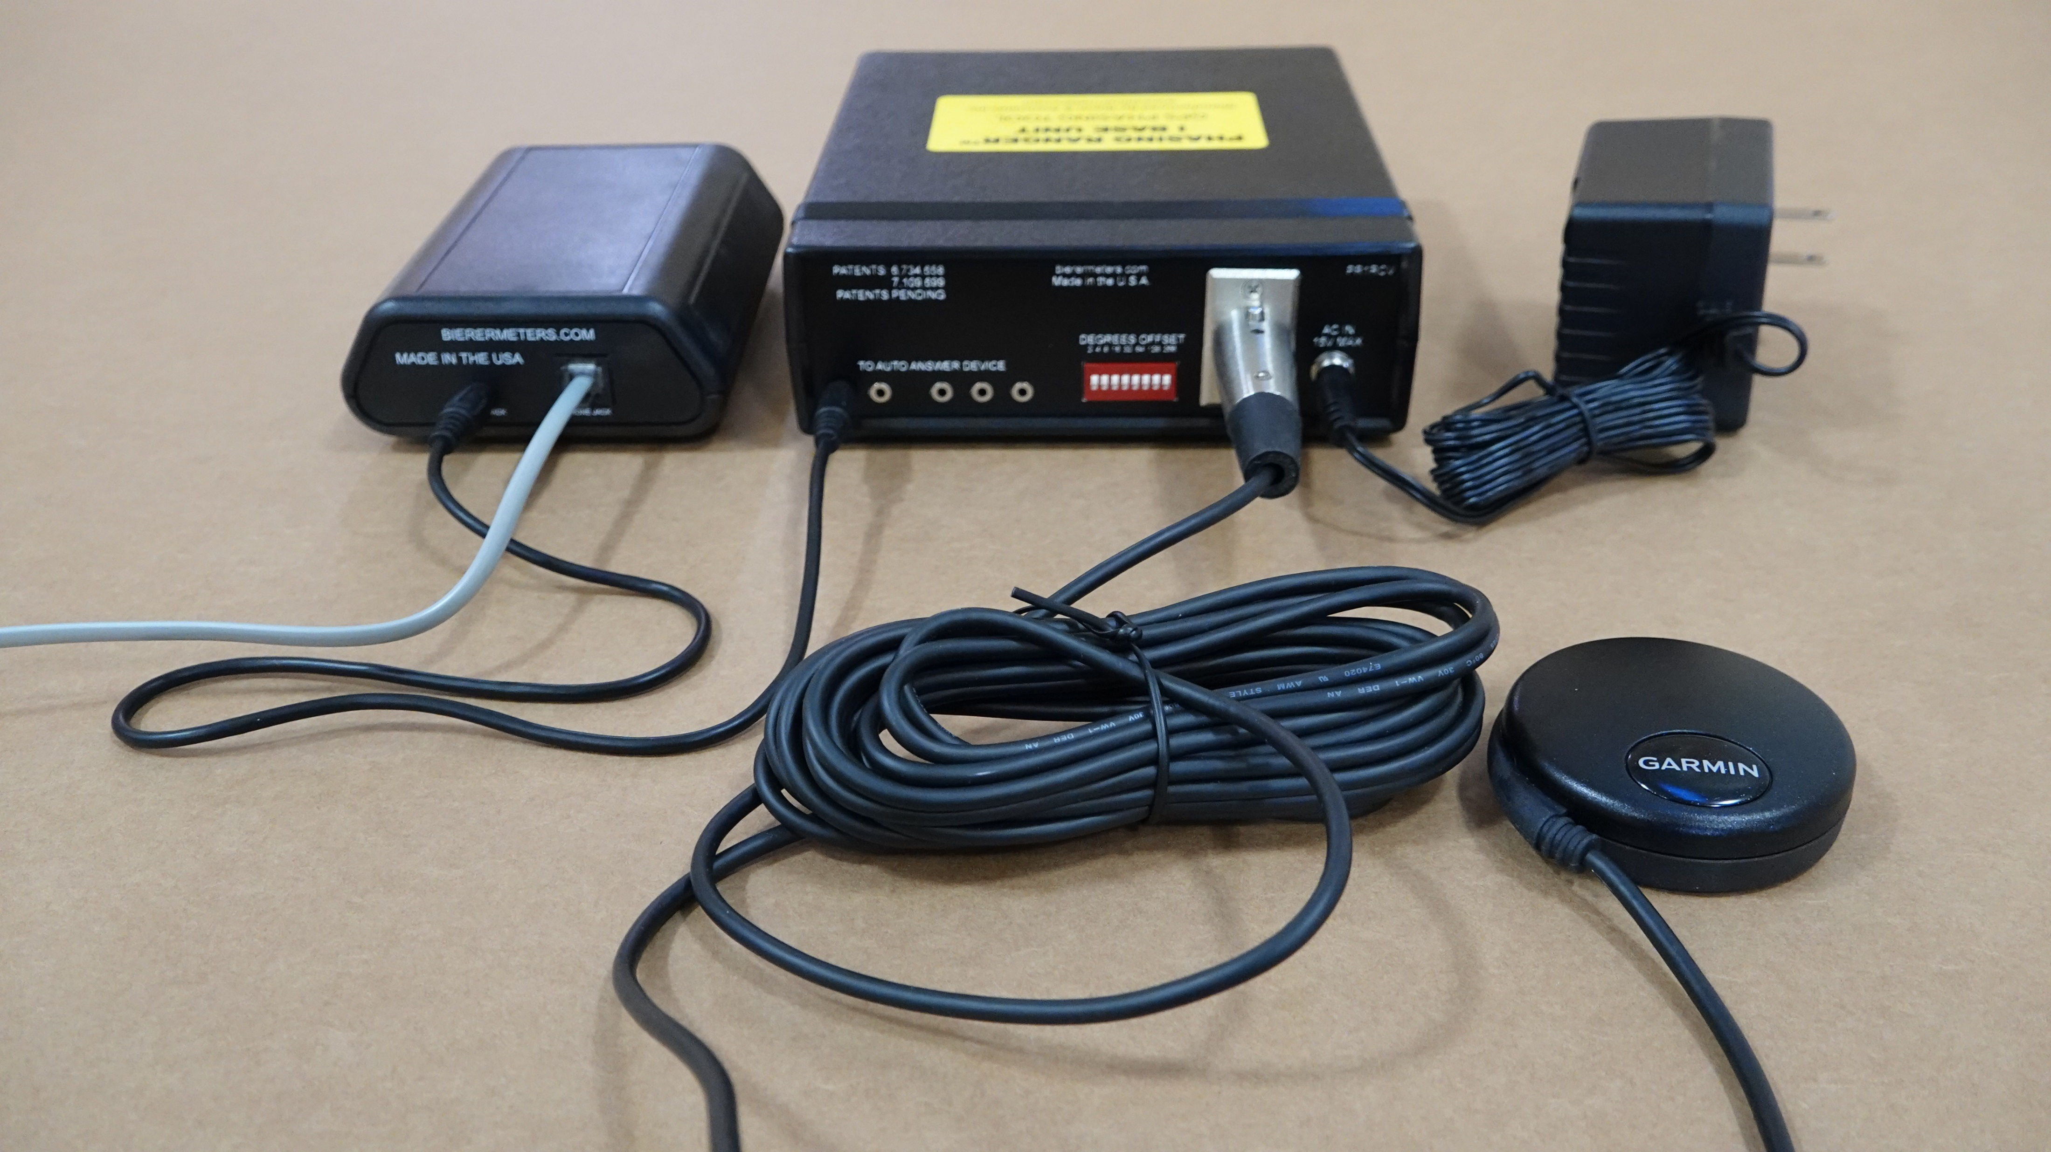
Equipment Overview
Base or Send Unit
120 Volt Power or
Reference Phase
Auto Answer
Device
Phone Line
Audio Cable
GPS and Cable

Slide 10
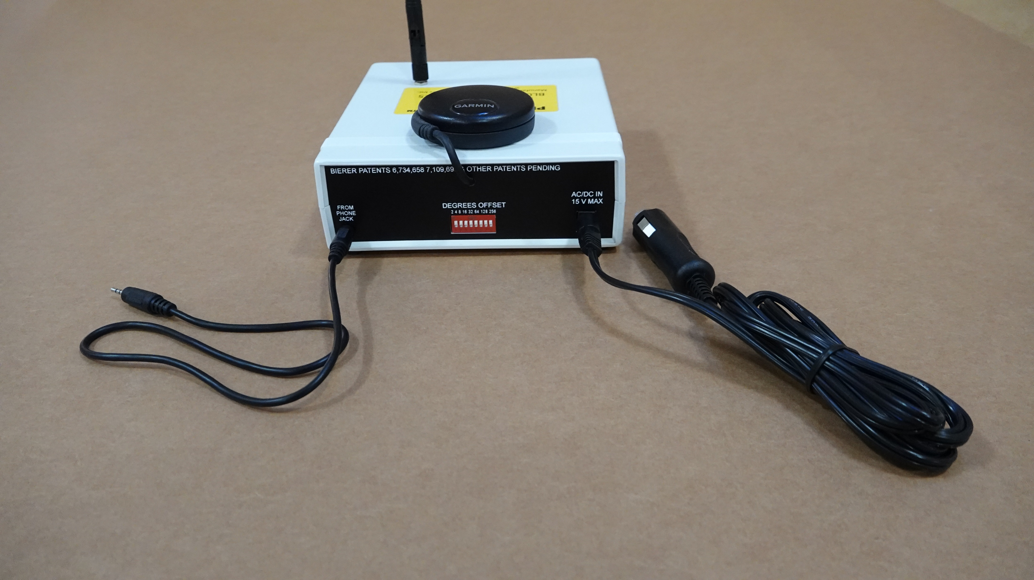
Equipment Overview
Field or Receive Unit
12VDC Charging Cable
also
120VAC Charging Cable (Not Shown)
Audio Cable, for connection
to Cell Phone or connection
can be made via Bluetooth
without the Audio Cable

Slide 11
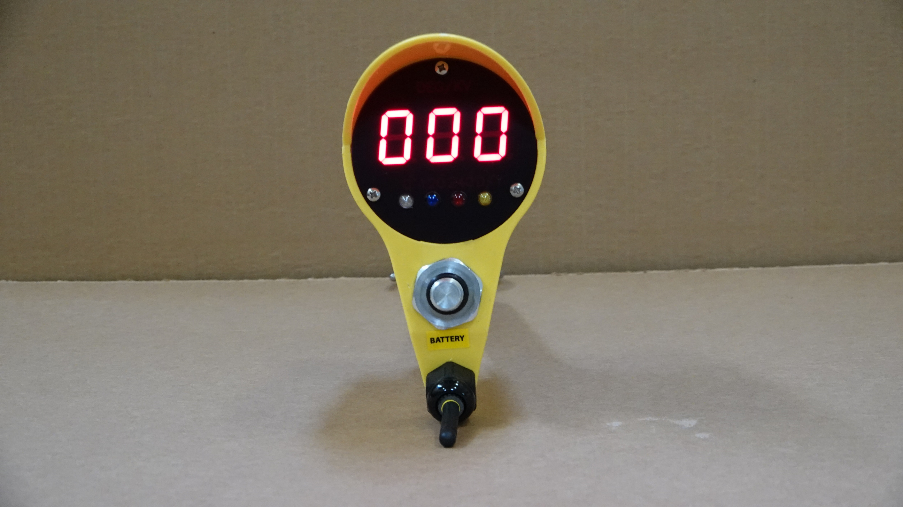
Equipment Overview
Meter Probe
Degree or Voltage Display
0 Degree White Light
Delta/Wye Yellow Light
120 Degree Blue Light
240 Degree Red Light
Note: Colored Degree (0, 120 and 240) Lenses can be swapped or moved to better match a specific Utilities color coordination. Example, the “Blue” 120 degree lens is swapped with the “Red” 240 degree lens, so the color sequence on the Meter Probe becomes, “White” 0 degree, “Red” 120 degree and “Blue” 240 degree.

Slide 12
Procedure
Initial Set-up for the Base/Send Unit (Black Box)
Find the best suitable location for the Base Unit to remain indefinitely without disturbance. Also, preferably in a location that would least likely incur loss of power, i.e. substation house.
Verify that the Base Unit has a 120V source connected directly to the grid and not through any type of back-up power sources such as a UPS (Uninterruptible Power Supply) system. Plug in the power cord into the back of the Base Unit, but leave the Power switch in the “OFF” position.
Verify that the Base Unit has a land (not cellular) telephone line. The land line can go through a PBX (Private Branch Exchange) system as long as it supports calling party disconnect or A/B reversal. Up to 5 lines can be connected to each Base Unit and used simultaneously as long as each line is designated its own telephone number. Plug the phone line(s) into the Auto-Answer box(es) and then plug the audio cable(s) from the Auto-Answer box(es) into the back of the Base Unit.
Verify that the Base Unit GPS has an acceptable (outdoor) view (Southern Hemisphere) of the sky and plug the GPS cable into the back of the Base Unit. Turn the Base Unit power switch to the “ON” position. The Base Unit will flash the Red (Power) and White (1PPS) lights alternately with the Power light remaining on and the “1PPS” allowed time (possibly several minutes) to remain on and synch per its new location. Note: Do not mount the GPS near any SCADA equipment.
Once the “1PPS” light remains on and constant, call the telephone number(s) associated with the Base Unit to verify the “Reference” phase angle data and the automatic line disconnect. The phase angle data tone will sound similar to a fax machine and the line should disconnect whenever the call is stopped.

Slide 13
Procedure
Initial Set-up for the Field/Receive Unit (White Box)
Verify that the Field Unit has been fully charged.
Turn the Field Unit power switch to the “ON” position. The Field Unit will flash the Red (Power) and White (1PPS) lights alternately with the Power light remaining on.
Verify that the Field Unit has an acceptable view of the sky indicated by a flashing “1PPS” white light. The “1PPS” light may take a couple minutes to start flashing if you have recently moved or in a new location.
Once the “1PPS” light is continuously flashing, call the Base Unit phone number. Once the data tone is present, turn the audio on the cell phone to “speaker” and connect with either the supplied audio cable or via Bluetooth. Skip step #5 if connecting via supplied audio cable.
If connecting Bluetooth, the “pair” code is 7425, and once connected, the data tone should “mute” and the Bluetooth audio (separate from normal audio) should be increased to the maximum setting. Note the flashing “1PPS” light turn into a simultaneous continuous and pulsating light when the data tone “mutes”. Always connect to Bluetooth after the Base Unit number is dialed and the data tone is present.
If connecting via the supplied audio cable and still in speaker mode from step #4, turn the volume to the maximum setting. Insert each end of the audio cable, one into the Field Unit and one into the cell phone. Note the flashing “1PPS” light turn into a simultaneous continuous and pulsating light when the data tone “mutes”.
Once a continuous “1PPS” light has been established, turn on the Meter Probe to the “DEG” (Degree) switch position and make physical contact with an energized “known” phase. A “known” phase = what your utility refers to as A, B, C or X, Y, Z or 1, 2, 3, etc.

Slide 14
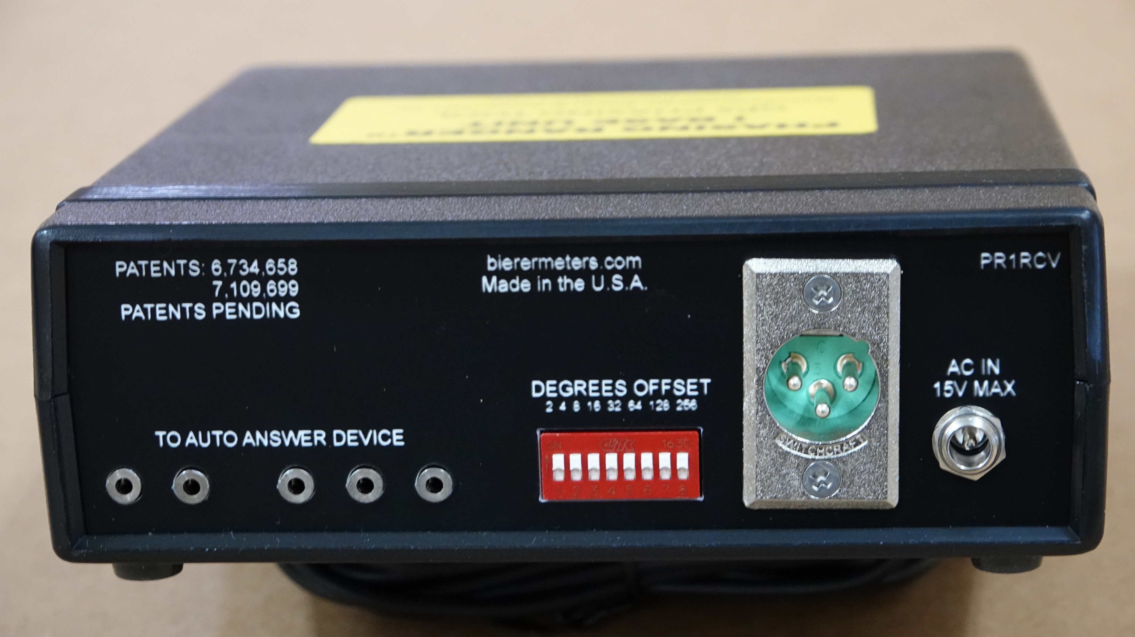
Procedure (continued)
Initial Set-up for the Field/Receive Unit (White Box)
Note: For Steps 8 - 11, it may require more than one person if the “Reference” phase (Base Unit) is located in a remote location.
With the ability to operate the binary dip switches located on the back of the Base Unit, and once physical contact is made with a “known” phase, make a note of the Meter Probe phase angle reading.
Flip “down” the binary dip switches
(see image) to reflect the
phase angle reading per the
“known” phase. As an example: If
the Meter Probe is physically
touching “A” phase and the initial
Meter Probe reading displays
“100”, but you would like “A” phase
to read “0” degrees, flip down the
binary dip switches, “64” and “32”
and “4”, i.e. 100-64-32- 4= 0
Adjust Dip Switches

Slide 15
Procedure (continued)
Initial Set-up for the Field/Receive Unit (White Box)
Now make physical contact with the other “known” phases and each should reflect the corresponding phase angle. Using the example in Step #9, “B” phase would display “120” and “C” phase would display “240” on the Meter Probe.
If this is NOT the correct phase angle(s) per your utility labels, go back to Step #9 and start over with all binary dip switches in the “UP” position and flip down the corresponding dip switches to reflect the correct phase angles.
Note: The Field Unit is also equipped with Binary Dip Switches. It is recommended that these are not used in the initial set-up procedure and only used for the two reasons listed below.
If your system has Delta/Wye transformations, offset the phase angle reading (should be some multiple of 30 degrees) with Field Unit dip switches.
If you are visiting another grid, i.e. for storm repair, contract work, etc., offset the phase angle reading between the two grids with the Field Unit dip switches so you can now Phase and Identify Phases.

Slide 16
Features
Real-Time Phase Angle Readings for any Nominal 3-Phase Voltage Potential in either URD (including Capacitive Test Points) or Overhead Conditions
Mapping and Tagging or Upgrade Existing/Outdated Maps
Correct Phasing or Phase Identification in Storm Restoration
Identify Phases for Load Balancing or Shift Loads to Prevent Imbalances
Mobile Substation Phasing
Flags Delta/Wye Transformations
Unlimited Range between Base Unit and Field Unit*
100ft. – 300ft. (line-of-sight) Range between Field Unit and Meter Probe
Field Unit Lithium Ion rechargeable batteries, up to 8hrs continuous use anywhere in the field
Can be used for Phasing Indoors (Commercial/Industrial, Underground Vaults, etc.) 10 min. at a time.
FCC Compliant
*Satellite phone may be required to overcome cell phone coverage issues.

